Slide 1
Advanced Manufacturing Technician
Distribution Day
Phase part 2

Slide 2
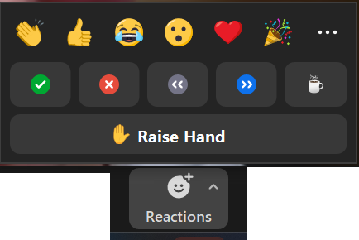


Pre- Session reminders
1. Please mute yourself when you are not speaking.
2. Video is welcome but optional.
3. If you have a question, you can put it in the chat, don’t wait!
4. If you have a question, raise your hand, don’t wait!
5. If you understand and are able to follow along or “got it”, please choose an emoji throughout the meeting to give reaction feedback or use the chat for feedback!

Slide 3
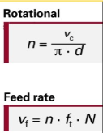
YELLOW PREP Questions
Feeds and Speeds
Pay attention to your units of measurement!
If your Vc is m/min and diameter is in mm, be sure to multiply the velocity by 1000 or divide your diameter by 1000 for the units to match.
Ex:
n=Vc / (π*d) Finishing
n=70m/min / (π*13mm) convert 13mm to .013m
n=70m/min / π*.013m
n=70m/min/.0408m
n=1715min-1
Calculating MASS of a part:
This is an example in the Blue Book Exercises and often a question on the exam – especially Part 2

Slide 4
YELLOW Prep Questions
Sw – width across flats is in the blue book 218
Calculating mass – what information to do you need? Material, material density in kg/dm3, dimensions, proper equations for volume (lxwxh in dm) and mass (density x volume)
Explain the dimension M5 x 10/14 on drawing 5
If a question on the test says to write out your step by step work plan for a part and include tooling, feeds, speeds and you write #14 “ drill 6 holes, 3 are tapped, 210 rpm for drill and hand tap” is this a complete answer? Or for #21 - “lathe, cutter bit, RPM 500, hand fed”
Vs. 1. Clamp the piece in the mill vise. Front facing up.
2. Zero the piece.
3. Use 12mm end mill and do two passes. One for the 12mm, and one for the +.1mm. Speed 900 rpm. Feed .032mm. 2mm deep
4. Use center drill at 900rpm at the three 8.5 bores and the M10 threaded bore
5. Use 8.5mm drill bit at 700rpm for three 8.5mm bores and the M10 bore.
6. Flip the piece so the bottom faces up.
7. Use center drill at 900 rpm at the two M5 holes.
8. Use 4.2mm drill bit at 950rpm at the two m5 holes. 10mm deep.
9. Use M10 tap to completely thread the m10 bore via blueprint
10. Use M5 tap to thread the M5 hole via blueprint.
Notes:
For those of you who said “no” to when you get your phase 2 drawings…it’s today.

Slide 5
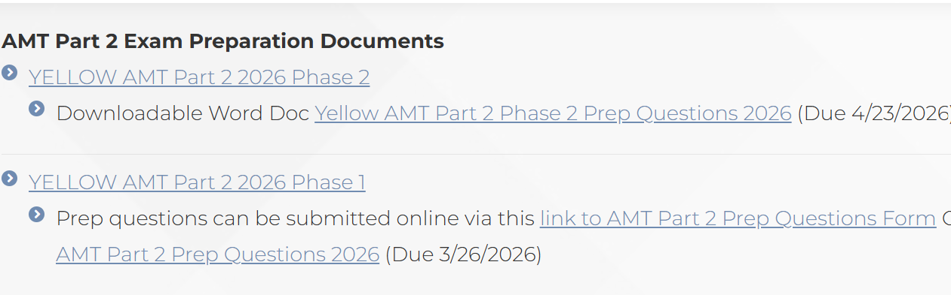
YELLOW PHASE 2
Downloadable from the ICATT resource webpage

Slide 6
Yellow phase 2
PHASE 2 IS YOUR PRACTICAL EXAM – These prints show what you will have to do on exam day.
Your material should be pre-fabricated, assembled, and brought to the exam according to the YELLOW Part 2 Phase 1 documentation
Use these Phase 2 drawings to determine your tooling
The circled item numbers in the Phase 2 drawings indicate the part has already been pre-fabricated and no machining will need to be done to that part on exam day.
The non-circled item numbers will be machined or modified on exam day.
Encircled dimensions will be inspected by the exam board

Slide 7
Yellow PHASE 2
What can/should you assemble PRE-exam?
Phase 1 – pre-exam assembly VS. Phase 2 – final assembly

Slide 8

Yellow phase 2

Slide 9
Yellow phase 2
Item numbers that are not
circled will be completed on
Exam day.
Why are the dimensions 11 and 3 encircled?

Slide 10
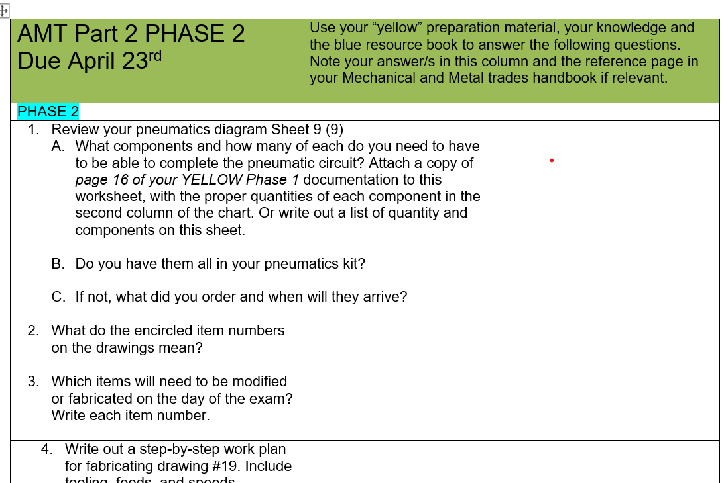
YELLOW Prep-Questions
YELLOW Prep Questions Phase 2 worksheet
Trainers review documentation with apprentice or review after completed and both sign worksheet (OR trainer sends the doc or is copied on the email to Geneva)
DUE April 23rd to:
Geneva - Scurek@gaccmidwest.org
Notes:
Where do you find the prep-questions?
When are they due?

Slide 11
Reminder - EXAM Expectations
Part 2 exam
To pass and earn your certification you must:
Pass the practical with a min of 50%
AND
Pass the written with a weighted combined min of 50%
BUT
Have no written score (3 different subject areas) lower than 30%
AND
Have scores above a 50% in at least 2 of the 3 subject areas
AND THEN
Have a weighted combined part 1 and part 2 score of at least 50%
Turn in a digital logbook to GACC Midwest no later than June 30th
If your written scores are insufficient you will be offered a Supplemental Oral Exam

Slide 12
EXAM DATES and Expectations
Part 2 - 0.5 hours of planning (specific questions worth 20% of your score) + 5.5 hours to complete project
Typical Schedule the week of exams:
Practice day: Pre-exam unstructured practice time on equipment at testing site 4-8 hours (bring your own material to machine)
Pre-exam set up: 4-5pm the day before the exam OR 7:00-7:45am the day of your exam
Exam day: 7:45am/8am start until time called (5.5 +0.5 hours)

Slide 13
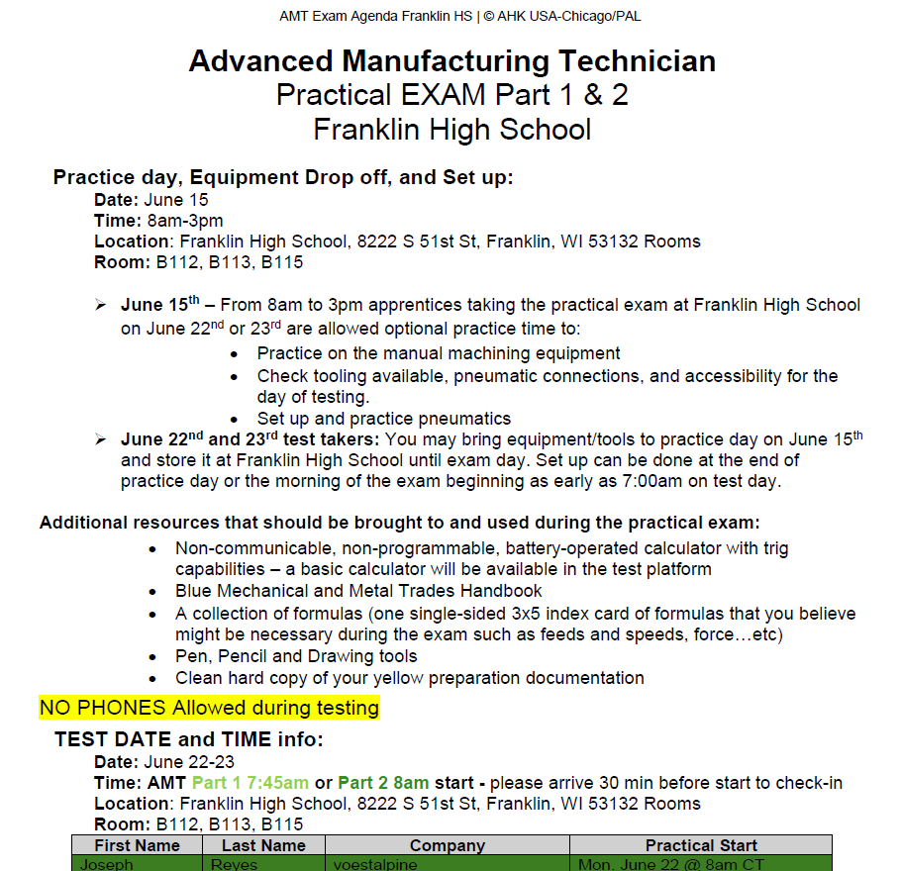
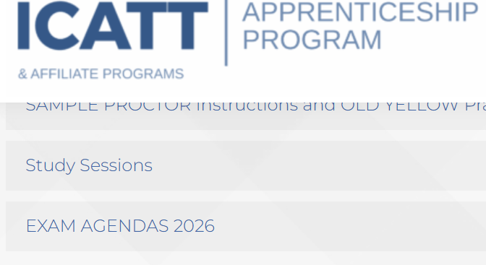
EXAM DATES and Expectations
A more detailed agenda of your practical and written exam will be posted on the ICATT resource page under

Slide 14
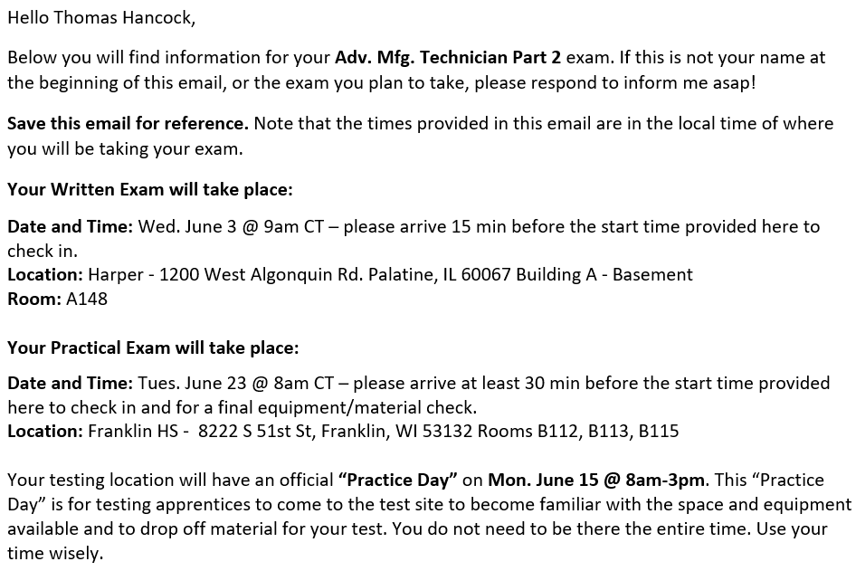
EXAM EMAIL
Details, including exact test dates, locations, start times for each test taker will be emailed to you by end of day to day.

Slide 15
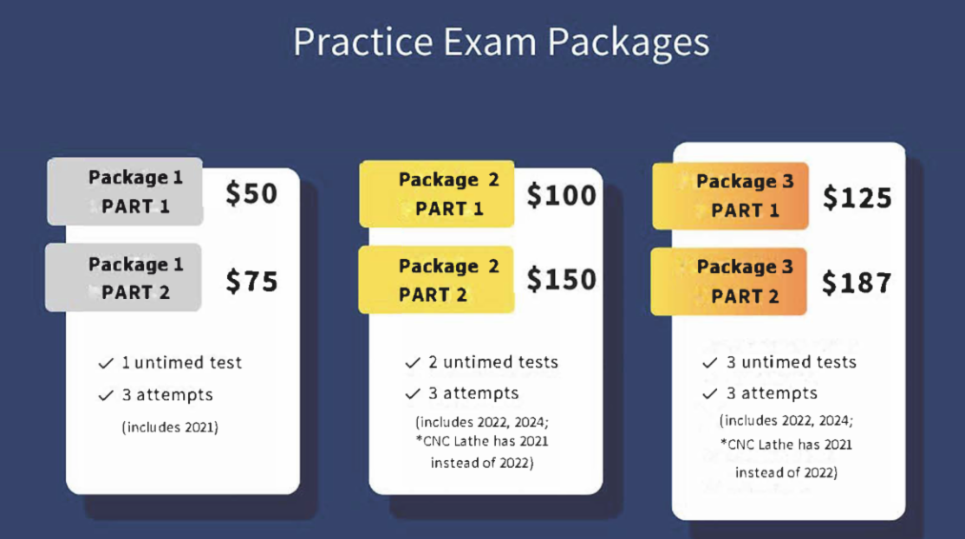
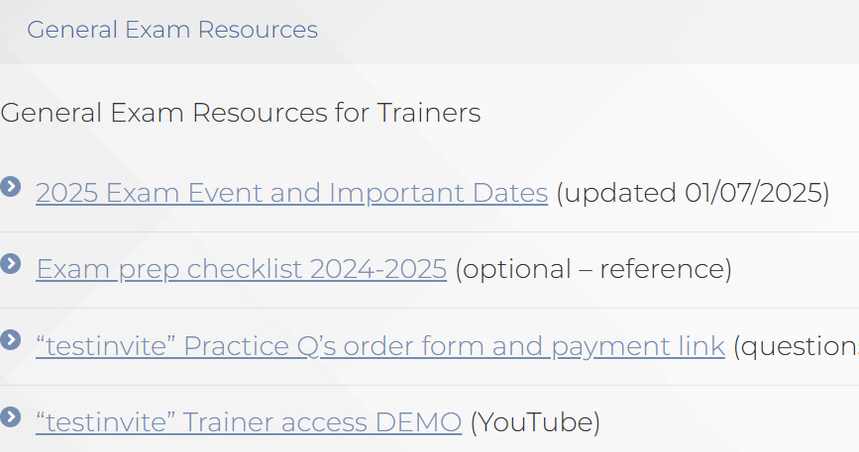
Reminders

Slide 16
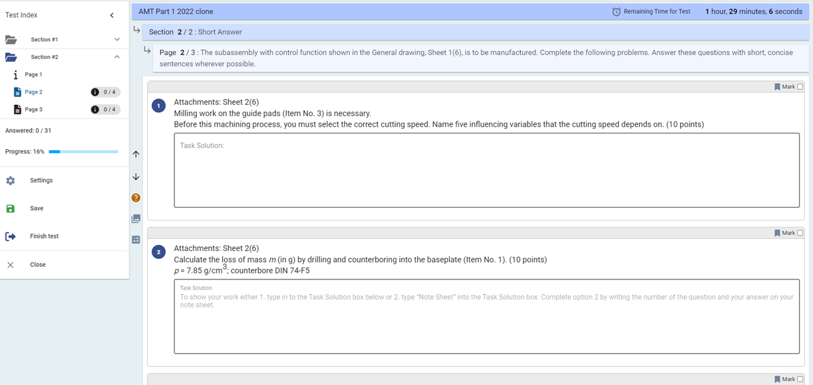
TEST INVITE
Time remaining
Shows here once you mark a question to go back to
Click box to mark a question
Reference drawings
Calculator (not trig capable)

Slide 17
REMINDERS
LOGBOOKS – send to scurek@gaccmidwest.org
Part 2 apprentices: your LOGBOOKS need to be complete and submitted digitally with records through at least May 31st – preferably when you come to testing and at the latest June 30th – we need them on record for your certifications.
CALCULATORS
Non-programmable
Non-communicable
Should be able to do trigonometry (sin/cosin/tan)
BLUE BOOK ERROR
Pg 330, 332, 333 – Typo! Cutting velocity should be m/min!

Slide 18
Important Final Dates
Applies to all ICATT apprentices
DATE | WHO? | Description of EVENT or Deadline
Thursday, April 23 | AMT Part 2 Apprentices Due date– submission only scurek@gaccmidwest.org | MANDATORY! – Phase 2 Prep-Worksheet due, demonstrating that apprentice and trainer have read and are familiar with the “YELLOW” preparation documentation Phase 2 received April 10th – NO meeting
Friday, May 8 | AMT 8am CST | Mtg: Final Exam Prep TBD – Study and Q&A Optional virtual event

Slide 19
EXAM DATES:
AMT Part 1 & 2 Written Exam
College of Apprenticeship | Location | Written exam date
WCTC/MATC | WCTC | Wednesday, June 3, 2026
Ivy Tech CC | Ivy Tech (Franklin)
Harper/Elgin/Oakton | Harper
Hennepin | Hennepin (Eden Prairie)
Metro | Metro Fort Omaha
Macomb | Macomb
AMT Part 1 & 2 Practical Exam
College of Apprenticeship | Location | Testing date | Practice Day
Hennepin | Hennepin (Brooklyn Park) | June 9-10, 2026 | Mon. June 8th
Metro | Metropolitan (CAM) | June 11-12, 2026 | Wed. June 10th
Macomb | Henry Ford College (main) | June 16-17, 2026 | Mon. June 15th
Ivy Tech CC | Endress + Hauser | June 16, 2026 | Mon. June 15th
WCTC/Harper/Elgin/MATC/Oakton | Franklin High School | June 22-23, 2026 | Mon. June 15th

Slide 20
FINAL Reminders
Phase 2 Prep-Questions Due April 23 (to Geneva)
Final Q & A: May 8 (8am CT/9am ET)
Expect an email with individualized details of your written and practical exam by End of Day today, April 10 to your PERSONAL EMAIL
Review detailed agendas (by test site) under Exam Agendas 2026 on the resource page

