Slide 1
Industrial Electronics Technician
Distribution Day
Part 1

Slide 2
AGENDA
YELLOW Preparation Documentation
Part 1
Commissioning
Prep-Questions
FYI - reminders
Important Dates
Notes:
Thank you to those that completed the practice exam and turned in their feedback form. If you have not yet attempted or you attempted and learned that you needed more practice, then please make time for that!

Slide 3
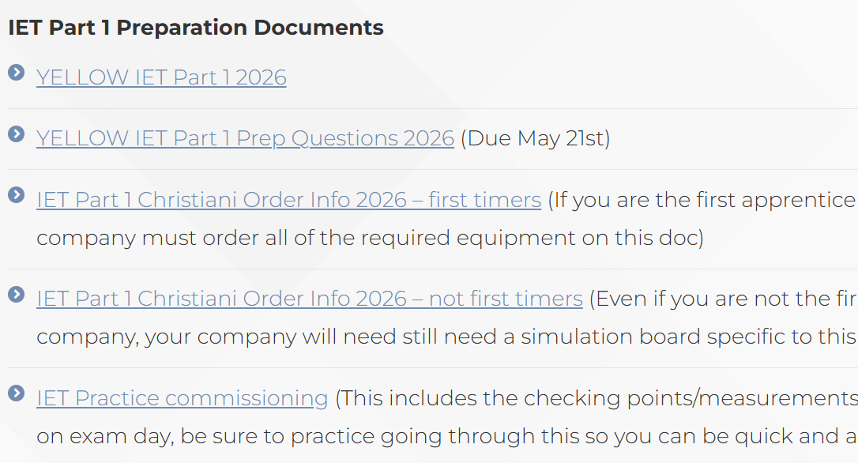
YELLOW DOCUMENTATION
https://www.icattapprenticeships.com/resources/apprentices/

Slide 4
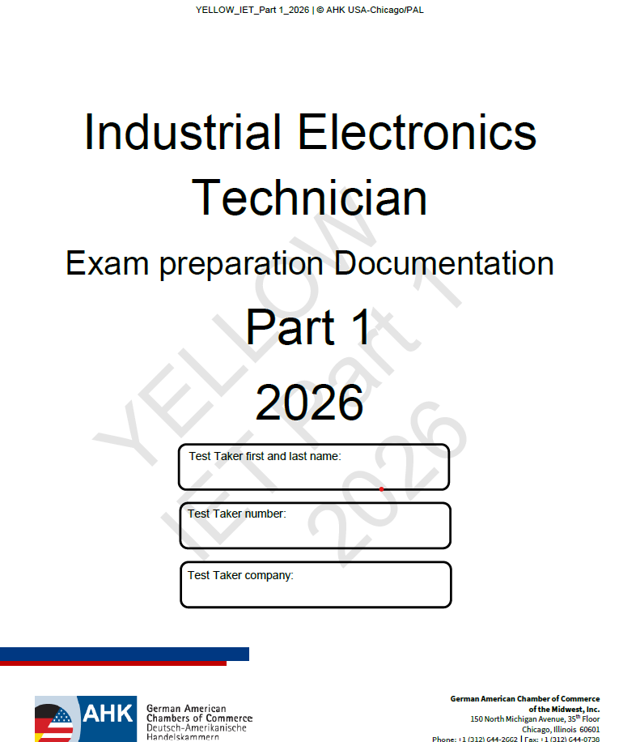
YELLOW Documentation
“YELLOW” indicates PRE-Exam information/work
- these documents are watermarked as YELLOW and ideally is printed on Yellow paper
Information on the Yellow documents includes
  Tools
  Equipment
  Hardware
  Connection requirements
  Pre-work
________________________________________
Part 1 has pre-work to complete
  Estimated time 6 hours for pre-work
  Pre-work to “Yellow” documentation must be complete by Exam Day the week of July 14th
Notes:
What should you do with the Yellow Documentation?

Slide 5
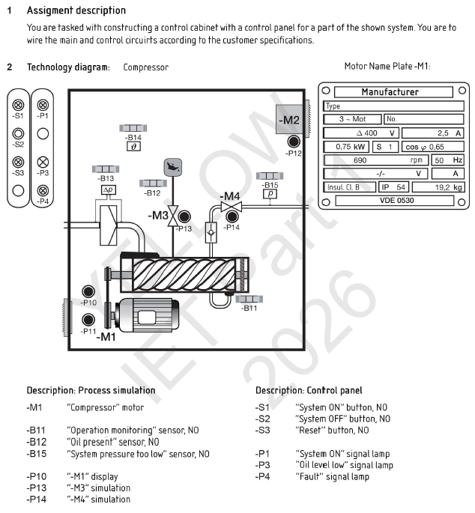
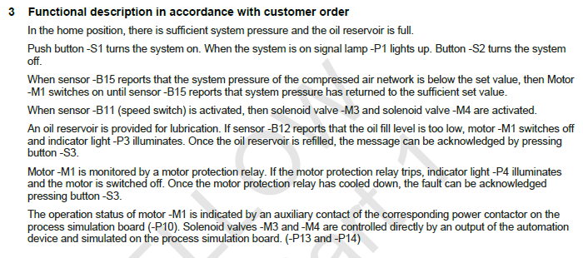
YELLOW Documentation Part 1
Complete your system according to the information provided. Do not add anything or connect anything not shown in the yellow drawings provided

Slide 6
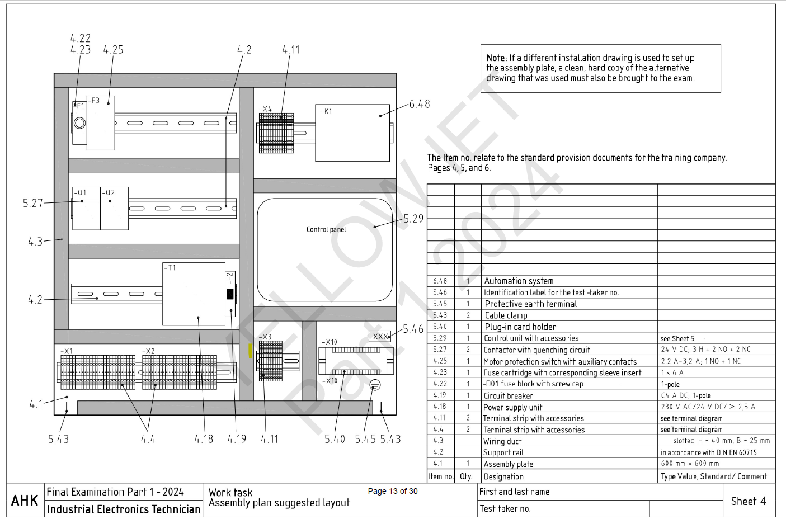
YELLOW DOCUMENTATION Part 1
Standard Material Staging List Documents are on page 4, 5, 6 of your yellow documentation.
5.45 = Page 5 item 45
4.1 = Page 4 item 1

Slide 7
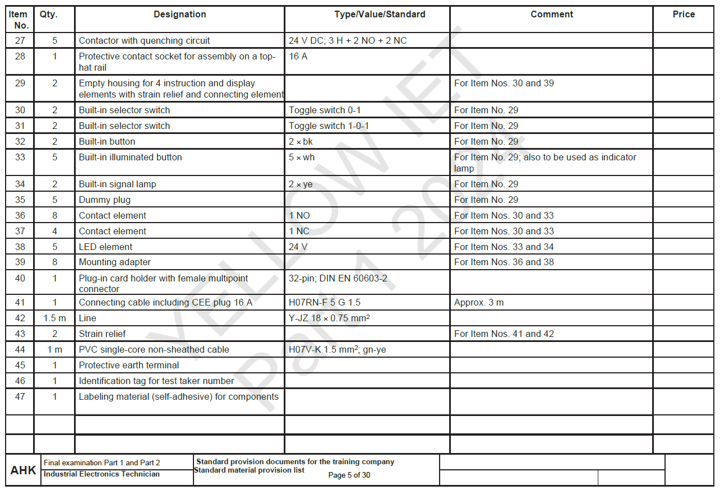


YELLOW DOCUMENTATION Part 1
Standard Material Staging List Documents are on page 4, 5, 6 of your yellow documentation.
5.45 = Page 5 item 45
4.1 = Page 4 item 1

Slide 8
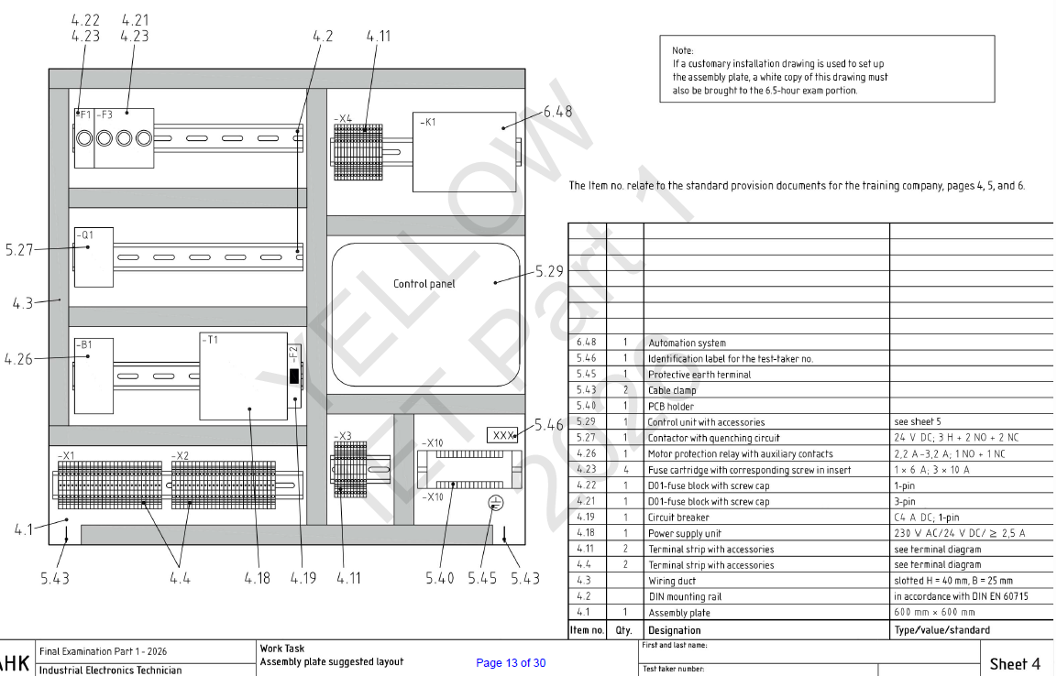

YELLOW Documentation Part 1

Slide 9
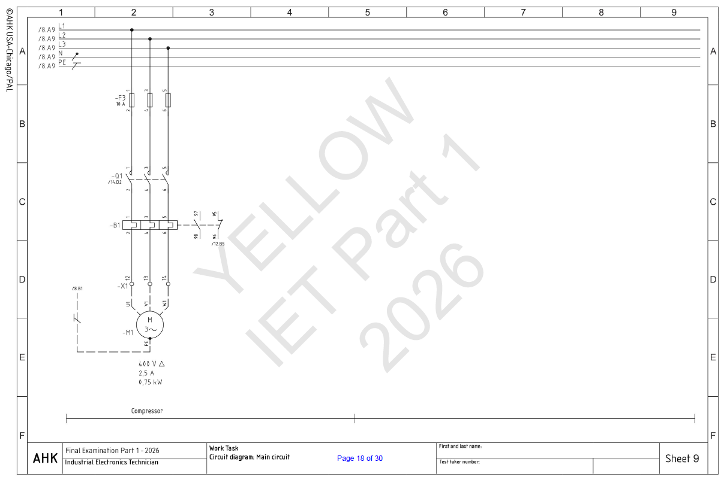
YELLOW DOCUMENTATION PART 1

Slide 10
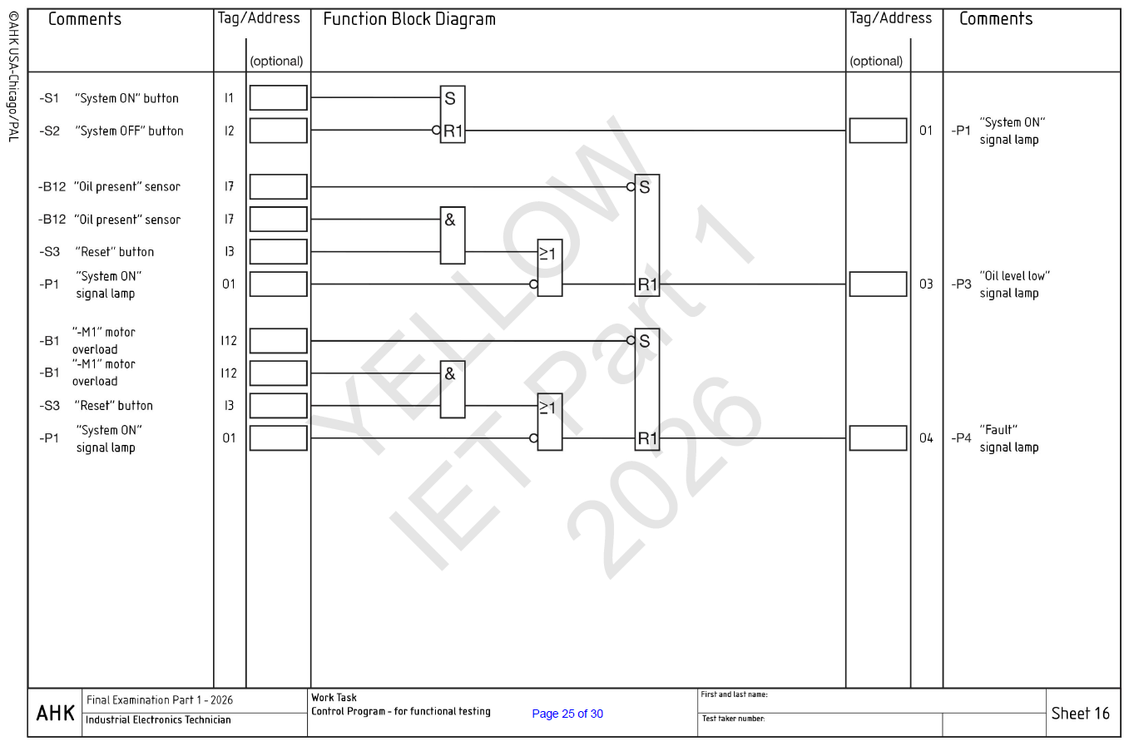
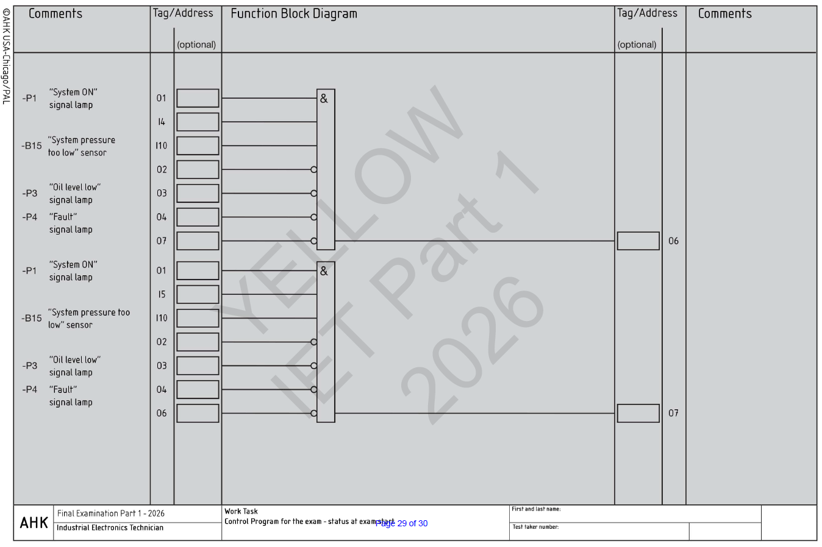
YELLOW Documentation Part 1
Gray= control program for exam – status of equipment at exam start
No color = control program for function testing

Slide 11
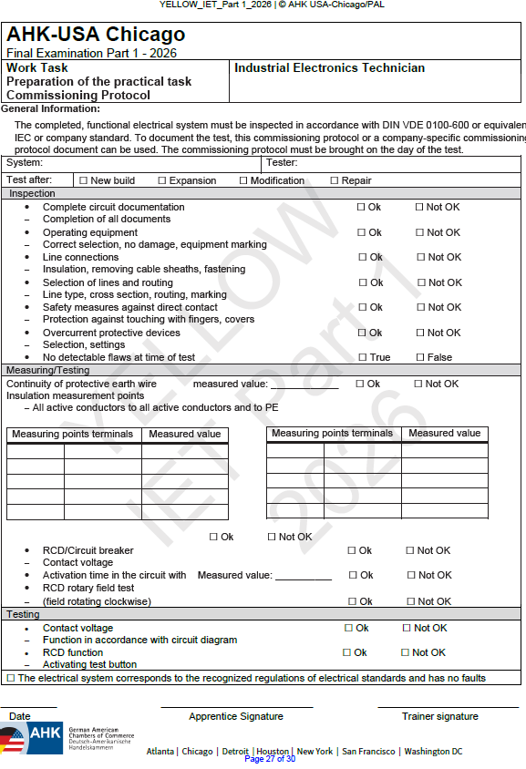
YELLOW DOCUMENTATION Part 1
Pre-Exam Commissioning

Slide 12
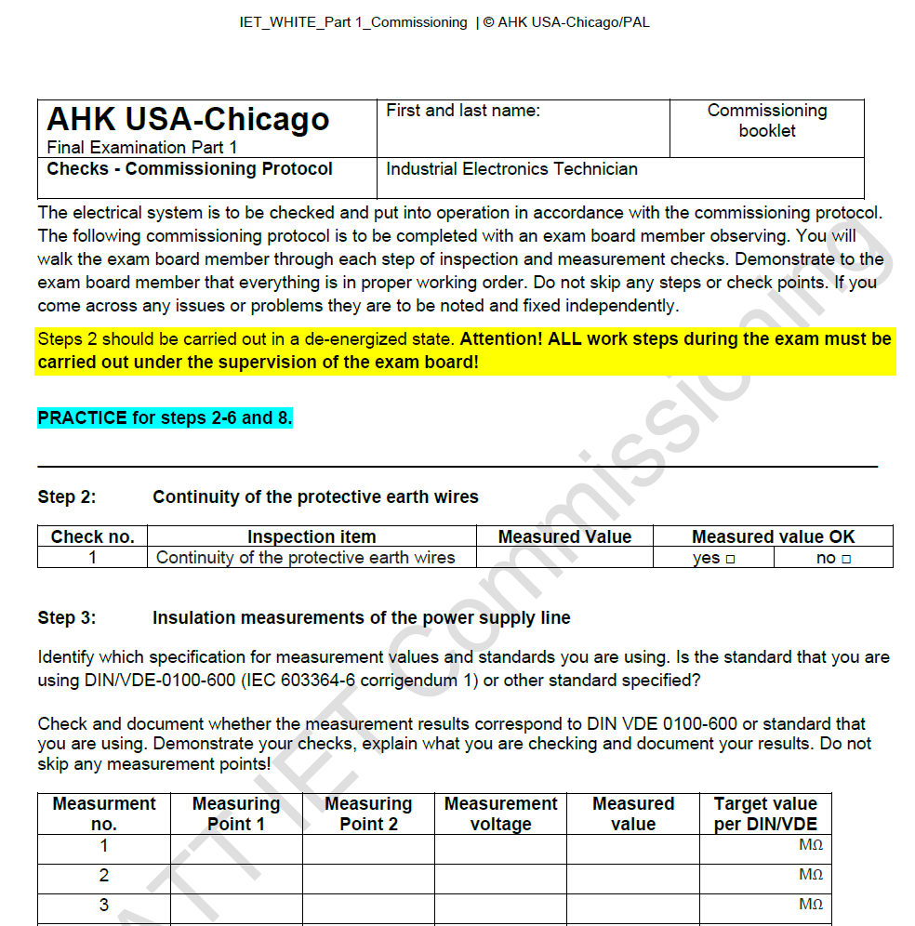
Exam Commissioning
Guide is provided for practice
Part 1 will be provided a commissioning document for the exam, on exam day

Slide 13
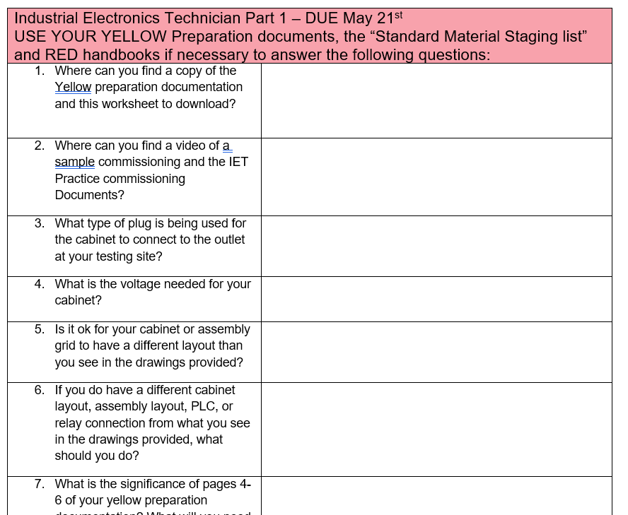
YELLOW Prep-Questions
YELLOW Prep Questions worksheet
Acts as a review of important information for exam day- use the following:
  Yellow Preparation Documentation
  Standard Material Staging list
  Red Electrical Engineering handbook
  Important Dates doc
  Trainers review documentation with apprentice or review after completed and both sign worksheet
DUE May 21st to:
Geneva - Scurek@gaccmidwest.org
Notes:
Where do you find the prep-questions?
When are they due?

Slide 14
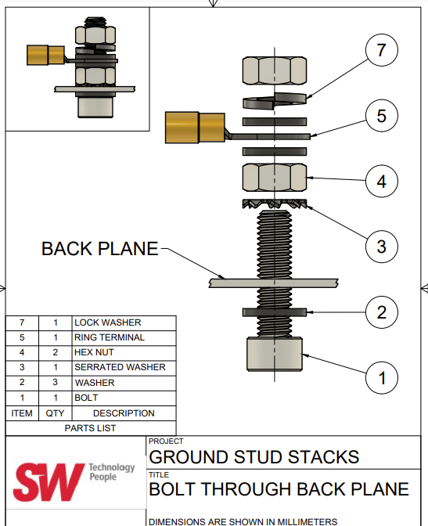
REMINDERS
Proper Grounding

Slide 15
REMINDERS
MODIFICATIONS
If your set up differs from the drawings provided, note and initial the change including the date the change was made using the following format i.e. GS 01/FEB/24
LOGBOOKS
KEEP A LOGBOOK – Daily. You will not turn them in this year, but you will at the end of next year.
CALCULATORS
Non-programmable
Non-communicable
Recommend that it is able to do trigonometry (sin/cosin/tan) if you are bringing one

Slide 16
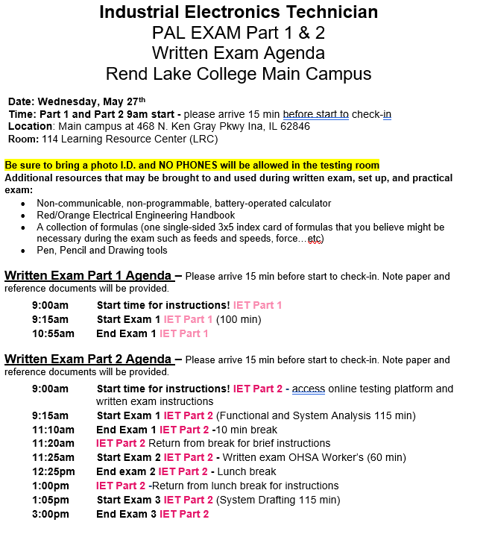
Reminders
EXAM SCHEDULE
Day 1 written
Part 1 – 100 min multiple choice and short answer
3 multiple-choice questions you can skip,
but they cannot be marked MANDATORY!!
Day 2 practical
Part 1 – 6.5 hours to complete project

Slide 17
EXAM DATES
IET Part 1 Written EXAM DATE
Written Exam DATE | Written Exam Location
May 27th | Rend Lake
IET Part 1 Practical EXAM DATE
Practical Exam Date | Practical Exam Location
July 14th | Continental Tire

